Slide 1
Process Improvement Opportunity: Better Than A Free Loan
Target Stakeholder Group: JPMorgan Chase & Co.’s clients

Slide 2
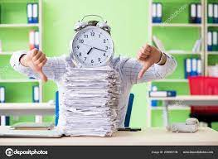
Paper Applications
They take a lot of time, take a lot of effort, many errors might happen, hard to track the progress and lastly hard to fix wrong info.

Slide 3
Key point, observation or data here…
Do you like to have a faster loan? You don’t have much time and the paper application takes tons of it and who knows if you meet the requirements or not. Something you don’t understand, a phone call isn’t enough to make it clear and a visit must be paid, missing info or mistyped ones needs another visit, you don’t feel VIP enough since 60% of the banks uses paper applications only/with electronic ones and you want to be a member of the other 40%, need to track your loan , process or whatever you want any time anywhere , then you must transfer to mobile app it’ll make it easier for you , you’d use your time effectively, finish the transactions faster with low to zero error from your home, maybe sitting on your couch or even didn’t move from your bed . You can do this and a lot more with finger touches. Have what is better than a free complex loan have a better service.
****Make Your Self A VIP****

Slide 4
Summary
No time to waste
No errors
Easy service
Easy tracking
Better understanding & communication

